Slide 1
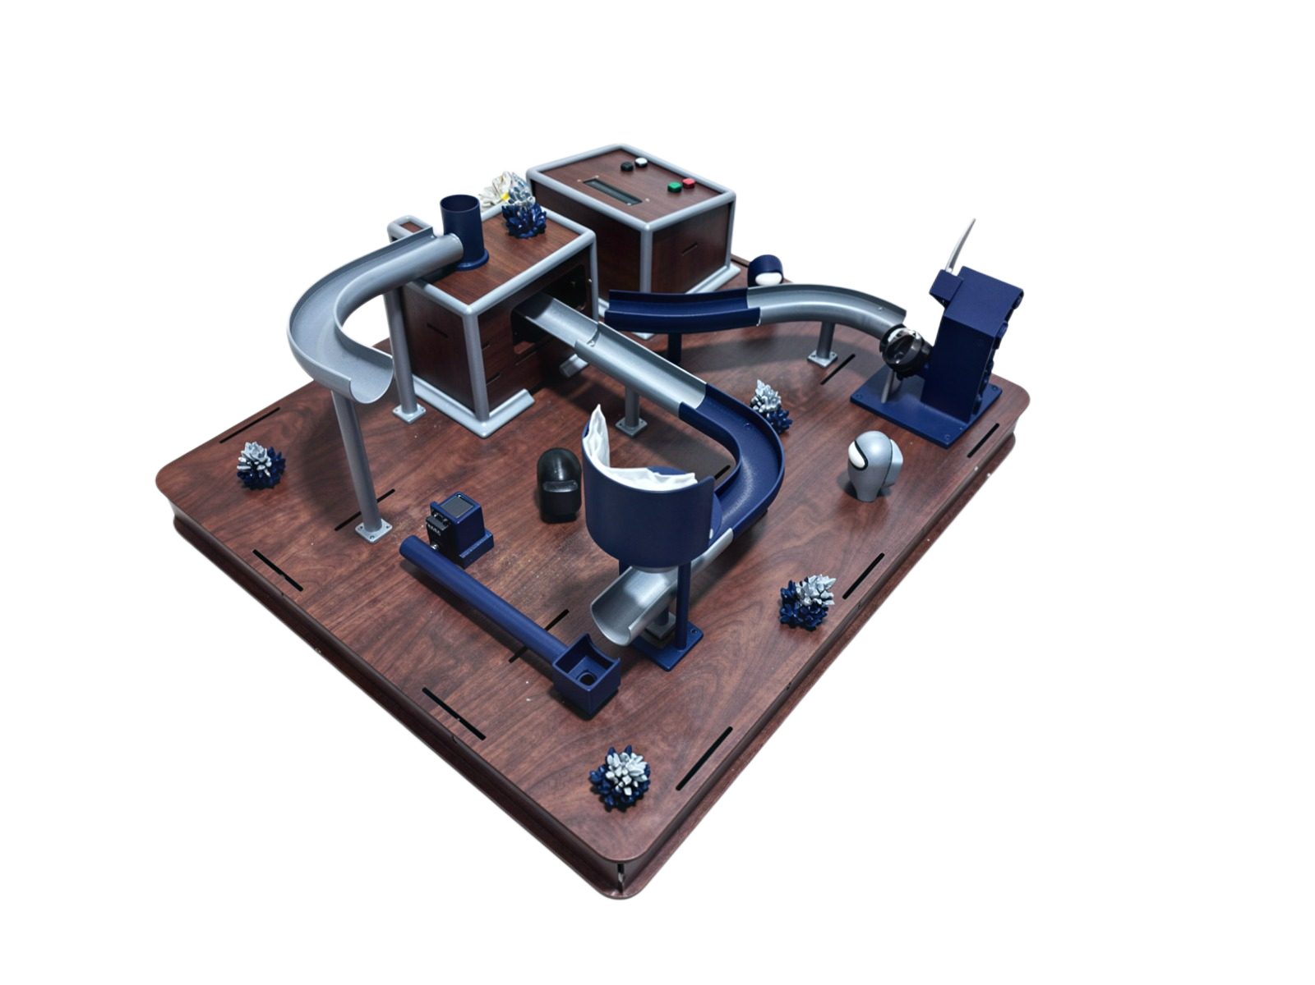
AIN SHAMS UNIVERSITY · MECHATRONICS ENGINEERING
AMONG US
An automated closed-loop sorting, shooting & lifting toy
MCT231 — Basics of Mechatronics
Academic Year 2025 / 2026
Supervisor: Dr. Shady A. Maged
TEAM · Omar · Anas · Teefa · Essa · Mario
AMONG US
MCT231
01

Slide 2








01 · CONTENTS
Agenda
Concept & Game
System Overview
Design & Build
Mechanisms
Theme, story, play loop
The closed-loop flow
CAD and real prototype
Sorting · Shooting · Lifting
Electronics
Application
Problems Solved
Results
Power, control & comms
App & Bluetooth link
Iteration & safety
Validation & outcomes
AMONG US
MCT231
01

Slide 3


02 · OVERVIEW
Project Overview
An electromechanical toy for children aged 2–10 that demonstrates an automated sort–transport–dispatch cycle as a continuous physical closed loop, with a companion app for play.
KEY SPECIFICATIONS
Controllers
Mega 2560 + Uno R3
Three mechanisms
Inter-MCU link
UART · 9600 baud
Colour sorting, projectile shooting, vertical lifting.
Interfaces
I2C LCD + Processing app
Wireless
HC-05 Bluetooth
Closed loop
Power
Single SMPS 220 V→12 V
Single marble inlet; no manual reloading during play.
Game
120 s timer · lives · penalties
Two microcontrollers
Arduino Mega (master) + Uno (slave) over UART.
AMONG US
MCT231
02

Slide 4

03 · CONCEPT
Theme & Story
Reactor defusal
Inspired by the cooperative game Among Us, the player stabilises a sabotaged lunar reactor by filtering pure fuel cells (white & black balls) from corrupted ones before the countdown expires. A correct cell advances the sequence; a wrong cell costs a life and adds a time penalty.
VISUAL IDENTITY
Navy
Lunar grey
Cyan
Red
AMONG US
MCT231
03

Slide 5




04 · GAMEPLAY
How It Plays
1
2
3
4
5
Generate
Input
Sort
Act
Loop
App creates a colour code & starts a 120 s timer
Player enters the code on the control panel
IR sensor reads each ball at the inlet
Match → shoot; mismatch → reject & retry
Lift returns every ball to the start
Correct sorting advances the defusal · incorrect sorting deducts a life + time penalty
AMONG US
MCT231
04

Slide 6


05 · ARCHITECTURE
The Closed Loop
RE-ENTER LOOP — continuous, no manual reload
MATCH
SORT
SHOOT
LIFT
IR colour read
DC motor fires
into funnel
Servo returns
ball to start
MISMATCH
RETURN PATH · bypasses shooter
AMONG US
MCT231
05

Slide 7
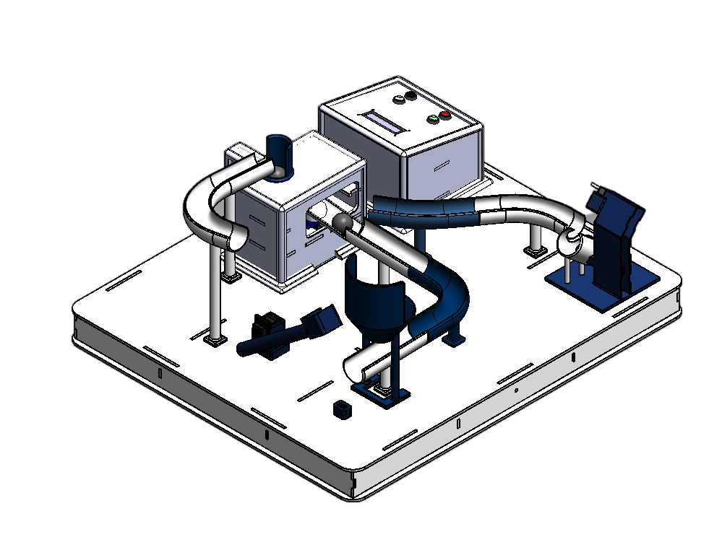
06 · DESIGN
CAD Design
Fully integrated assembly
Designed in CAD; laser-cut MDF chassis with 3D-printed marble tracks and funnels.
AMONG US
MCT231
06

Slide 8
07 · DESIGN
The Real Prototype
AMONG US
MCT231
07

Slide 9
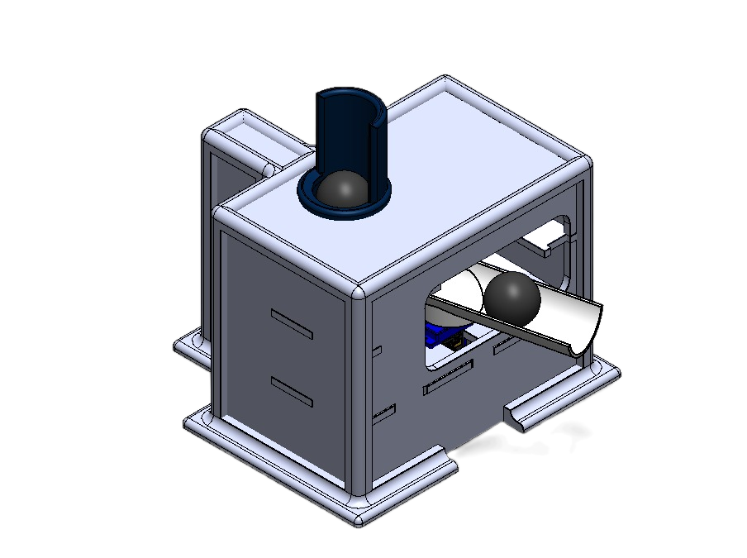
08 · MECHANISMS
Sorting Mechanism
Entry point of the loop. A presence IR detects the ball; the colour IR reads white vs black; servos route and release the ball.
Holder servo
Home 180° → Reach 90°
Path servo
Home 105° / Shooter 142° / Return 97°
Colour sensor
Emitter power-gated per read
AMONG US
MCT231
08

Slide 10
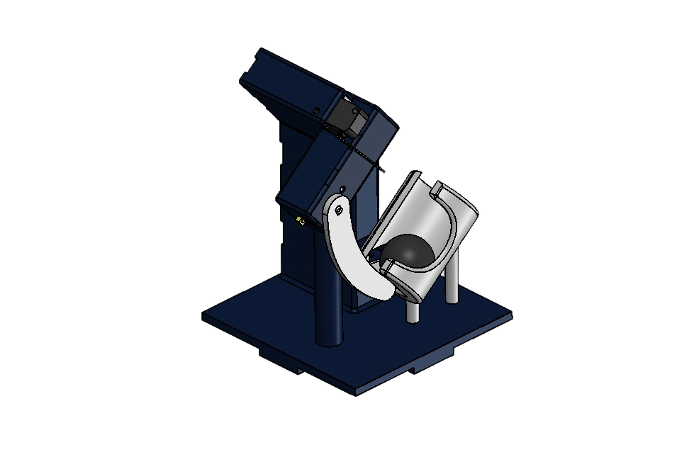
09 · MECHANISMS
Shooting Mechanism
On a match the ball rolls to the barrel; a DC motor driven by an L298N fires it into the funnel, then retracts to a limit switch to re-home.
Driver
L298N H-bridge (PWM)
Fire / retract
PWM 90 / 35 of 255
Target range
≈ 30 cm @ 45° launch
AMONG US
MCT231
09

Slide 11
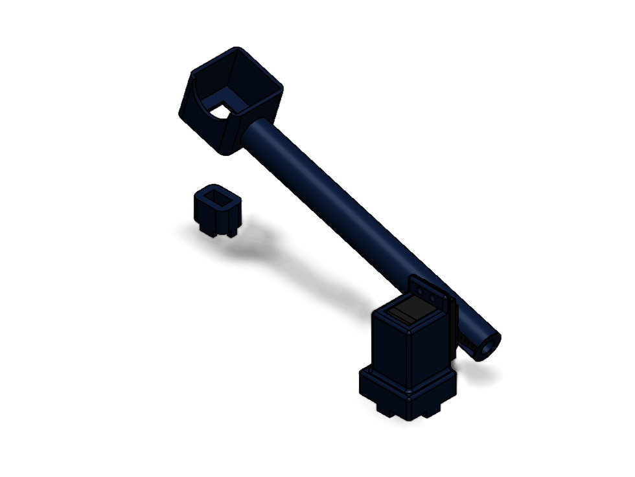
10 · MECHANISMS
Lifting Mechanism
Common return stage for both branches. A lift IR detects the ball; the lift servo raises it and returns it to the sorting stage, closing the loop.
Lift servo
Rest 0° → Lift 95°
Detection
IR at elevator base
Role
Guarantees every ball re-enters
AMONG US
MCT231
10

Slide 12


11 · ELECTRONICS
Power Architecture
12 V BUS
Single source · common ground · hidden wiring
L298N → DC motor
Shooter at 12 V
SMPS
Buck converter → servos
220 V AC → 12 V DC
Stepped-down servo rail
9 V regulator → Uno
Logic supply (VIN)
Two custom shield-PCBs (Uno + Mega) seat the boards on pin headers — no breadboards. Exceeds the ≥ 1 PCB requirement.
AMONG US
MCT231
11

Slide 13


12 · ELECTRONICS
Control & Communication
Arduino Mega · MASTER
Arduino Uno · SLAVE
UI, game logic, verification & comms
LCD · 4 buttons · HC-05 · BT-state pin
Sensing & actuation
5× IR · 3× servo · L298N + DC motor · limit switch
UART · 9600
MESSAGE PROTOCOL
Mega → Uno
“WBW…”
Player sequence
Built-in safety
Mega → Uno
“R”
Reset
Bluetooth-disconnect failsafe, remote app reset, and a reset routine that stops the motor, homes all servos, and clears the active sequence.
Uno → Mega
“D”
Tasks complete
App → Mega
“W” / “B”
Target code
Mega → App
“C” / “W”
Result
AMONG US
MCT231
12

Slide 14



13 · INTERFACE
Mobile App & Bluetooth
SCREENSHOT
Companion app
Generates the colour sequence, runs the 120 s countdown, tracks lives & penalties.
HC-05 link
Wireless serial pairing to the Mega for real-time, responsive control.
App screens: code, countdown, lives, result
Second interface
Pairs with the on-board LCD to present two distinct information sets.
Status: simulation-tested — final HC-05 pairing & serial integration in progress
AMONG US
MCT231
13

Slide 15
14 · ANALYSIS
Engineering Rigor
Every actuator is sized with the same chain: trapezoidal profile → inertia → phase torques → RMS → safety factor (1.5).
1.84
30
1.5
4.189
m/s launch speed
cm projectile range
safety factor (SF)
rad/s servo ωₘₐₓ
CORE FORMULAS
v = √(vₓ² + v_y²) v_y = √(2·g·ΔH) t_f = (v_y + √(v_y² + 2·g·y₀)) / g
J = ⅓·m·L² (rod) + m·L² (ball) T = J·α + g·(m·L/2 + m·L) T_rms = √(Σ Tᵢ²·tᵢ / t)
DC motor (L298N): I = T / K_t V = I·Rₐ + K_e·ω PWM = round((V/12)·255)
AMONG US
MCT231
14

Slide 16

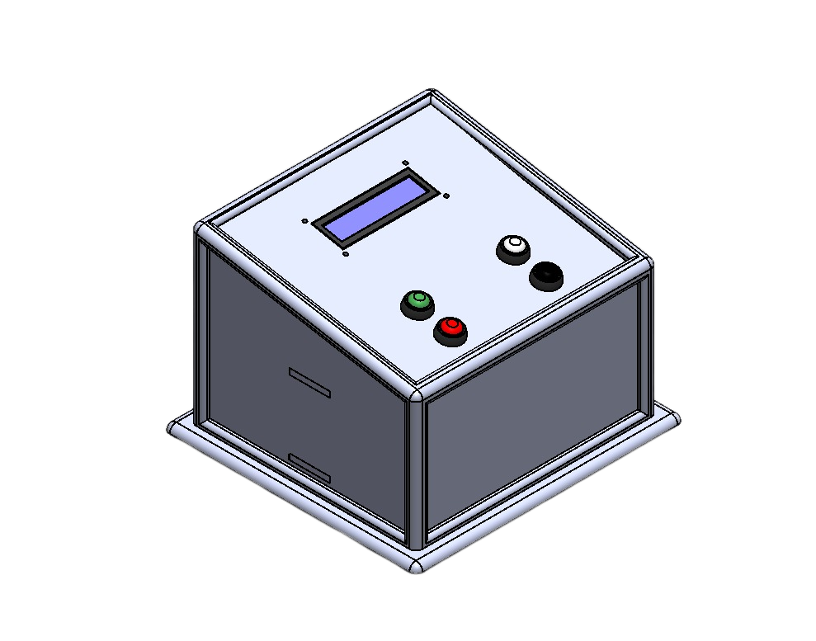
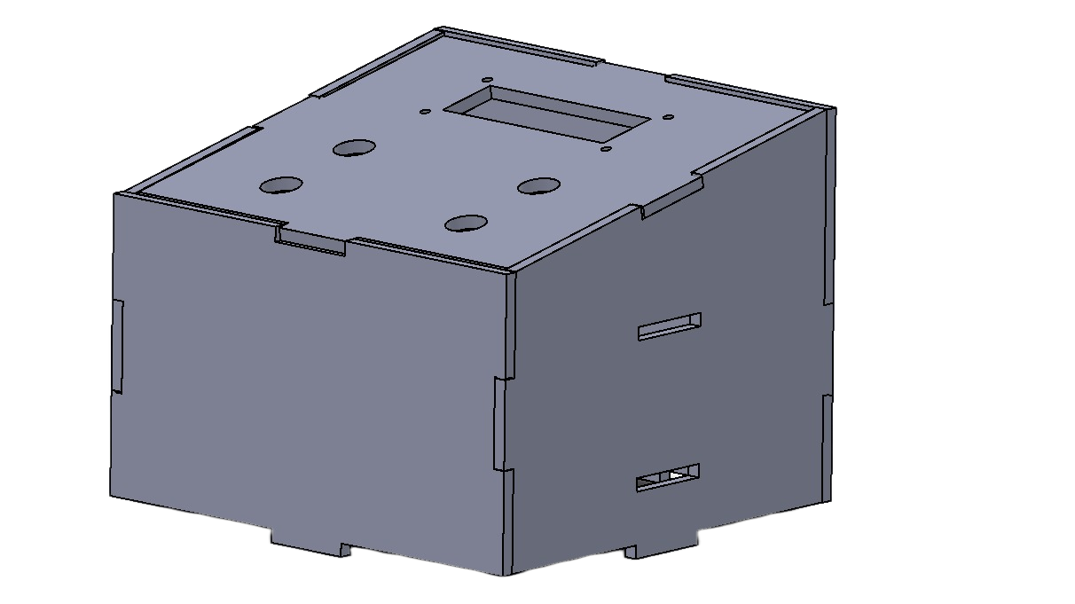

15 · ITERATION
Problem → Solution
Sharp MDF edges
Laser-cut MDF leaves hard, sharp edges — unacceptable for a toy aimed at children aged 2–10.
BEFORE
AFTER
SOLUTION · 3D-printed edge covers on exposed edges only (not a full enclosure) — removes every reachable sharp edge while keeping the mechanisms visible.
AMONG US
MCT231
15

Slide 17



16 · ITERATION
More Problems Solved
Exposed wiring
Loose jumper wires on the surface
Routed below deck + shield-PCBs; nothing reachable
Unreliable colour read
Stray light skewed white/black detection
Power-gated emitter + calibrated threshold
AMONG US
MCT231
16

Slide 18



17 · COMPLIANCE
Safety Considerations
No sharp edges
Hidden wiring
Guarded motion
3D-printed covers on all exposed MDF edges
Harness below deck; no accessible contacts
Moving parts shielded; choking review on balls
Single source
Stop control
Standards intent
One SMPS, common ground, no exposed mains
Physical start/stop + software reset
Aligned with CE / EN 71 toy safety
AMONG US
MCT231
17

Slide 19
18 · EXECUTION
Project Management
TEAM & ROLES
12-WEEK TIMELINE
A
Anas
CAD design
Documentation
Omar
Coding + CAD design
Mechanical / CAD
O
Firmware
T
Teefa
App, comms & code integration
App / Bluetooth
E
Essa
PCB, wiring, PDS, block diagram
PCB / Electrical
M
Mario
Calculations + documentation
Integration
W1–W12 · critical path: CAD → Firmware → PCB → Integration
AMONG US
MCT231
18

Slide 20
19 · OUTCOMES
Results & Assurance
≥ 95%
< 200 ms
50+
0
sorting accuracy target
actuator response
closed-loop cycles, no jam
dropped UART messages
VALIDATION · meets the goal
VERIFICATION · meets the spec
Correct cells advance; wrong cells rejected
App, LCD, lives & timer mirror the machine
Safe & engaging for ages 2–10
Servo set-points hit; PWM fire/retract verified
UART 9600 baud, zero dropped messages
Edge covers inspected; rails < 5% droop
AMONG US
MCT231
19

Slide 21

20 · HARDWARE
Core Components
Arduino Mega 2560
Arduino Uno R3
HC-05
Master controller
Slave controller
Bluetooth module
I2C 16×2 LCD
Servo motors ×3
DC motor + L298N
On-board display
Holder / path / lift
Projectile shooter
IR sensors ×5
SMPS + buck + 9 V reg
2× shield-PCBs
Presence / colour / barrel / lift
Power chain
Uno + Mega
AMONG US
MCT231
20

Slide 22


21 · CLOSING
Conclusion & Next Steps
DELIVERED
NEXT STEPS
Working closed-loop toy: sort, shoot, lift
Two-MCU master/slave over UART
Two interfaces: LCD + Bluetooth app
Two custom shield-PCBs, single SMPS
Child-safe finish via 3D-printed edge covers
Finish HC-05 pairing + serial in the app
Complete current-consumption measurements
Add sound effects & difficulty levels
AMONG US
MCT231
21

Slide 23

Thank You
Questions & discussion welcome
AMONG US · MCT231 · Omar · Anas · Teefa · Essa · Mario
AMONG US
MCT231
22

